Slide 1
Renewal PlanB Overview

Slide 2
planner Architecture
Web Interface
Authenticate Layer
Task/Job Service
Host Service
User Service
Monitoring Service
Metadata Control Layer
Task/Job Manager
Host Manager
Auth Manager
Data Access Objects
Image Manager
planB Adapter
Authentication Adapter
Bootable Device Maker
planB agents
Keystone
Database
USB/CD Interface

Slide 3
PlanB agent(PC/Windows)
User Interface(Qt)
Backup API
Restore API
User API
Task Service
Restore Service
User Service
Job Service
Backup Daemon
Backup/Restore Managers
Metadata Local Cache Manager
Password Manager
File Manager
System Manager
Image Maker
Target Adapter
Repository Adapter
Metadata
Adapter
Auth Adapter
Windows API
VSS
Swift
planner

Slide 4
planB agent 화면정의서

Slide 5
Loading
planB
Setup(scan planner, save config)

Slide 6
Login
ID
PASSWORD
Auto login
자동로그인 체크시 config 저장

Slide 7
Backup stage 1
Setup
Help
Backup
System Backup
Volume Backup
Recovery
File Backup
Status
Path: C:\Windows
찾아보기
Next
Select range(Volume, Directory, File)

Slide 8
Backup stage 2
Setup
Help
Backup
Once
Recovery
Periodic
Setup period
Status
Prev
Next
Select backup type, setup period

Slide 9
Recovery stage 1
Setup
Help
Title | Path | Time | Select
asdf | C:\ | 2016-10-25
qwer | C:\Windows | 2016-10-25
Backup
Recovery
+
Status
Next
Select backup

Slide 10
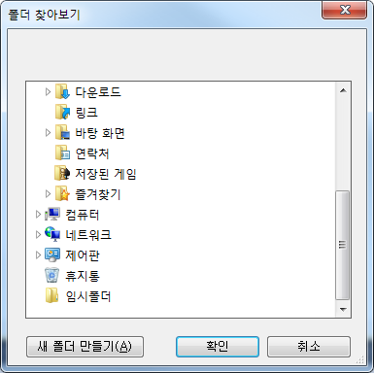
Recovery stage 2
Setup
Help
Backup
Recovery
Status
Prev
Next
Select target

Slide 11
Task list
Setup
Help
Title | Path | Period | Type | Option
asdf | C:\ | Daily(6pm) | Incremental
qwer | C:\Windows | Weekly (Mon, 1am) | Full
Backup
Edit
Del
Recovery
Edit
Del
Status
Select backup

Slide 12
Edit Task
Setup
Help
Backup
Recovery
Status
Next
Select range(Volume, Directory, File)

Slide 13
Backup stage 2
Setup
Help
Backup
Once
Recovery
Periodic
Setup period
Status
Prev
Next
Select backup type, setup period

Slide 14
Delete Task
Setup
Help
Title | Path | Period | Type | Option
asdf | C:\ | Daily(6pm) | Incremental
qwer | C:\Windows | Weekly (Mon, 1am) | Full
Backup
Edit
Del
Recovery
Edit
Del
Status
Select backup

Slide 15
planB 개발 계획

Slide 16
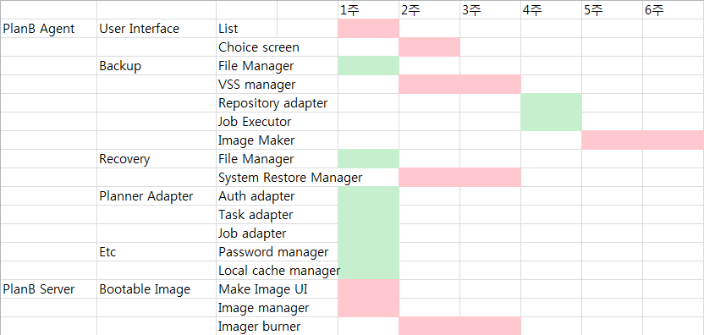

Slide 17
Issue
System incremental backup

